Slide 1


Slide 2


Slide 3
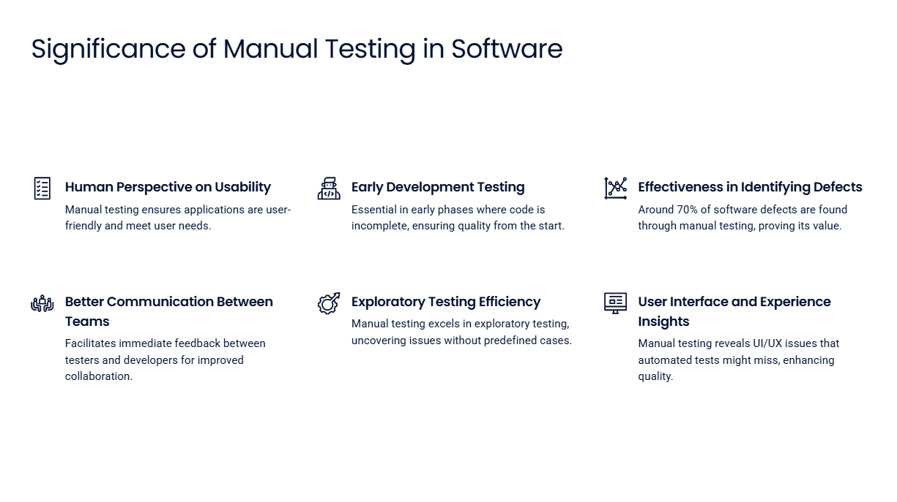

Slide 4
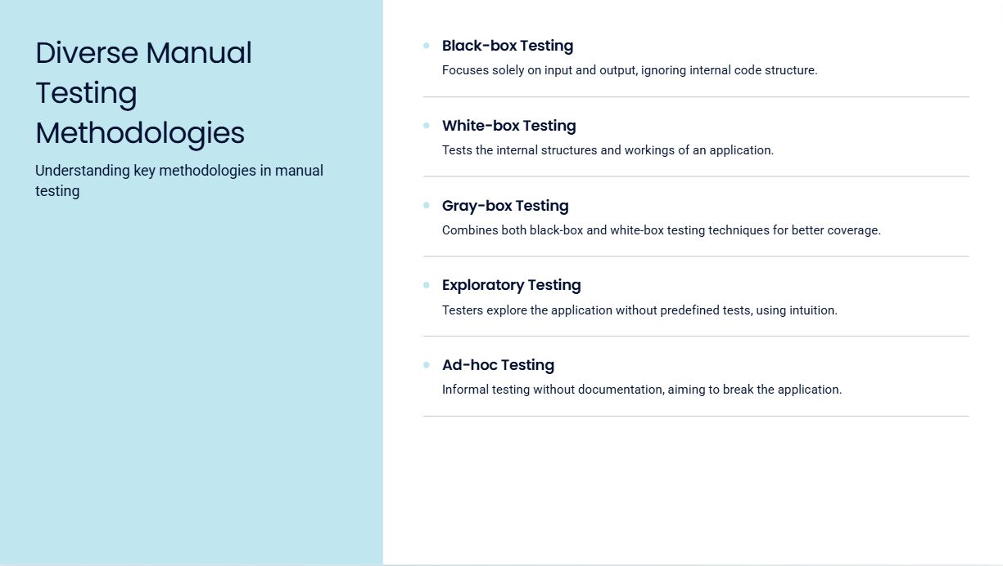

Slide 5
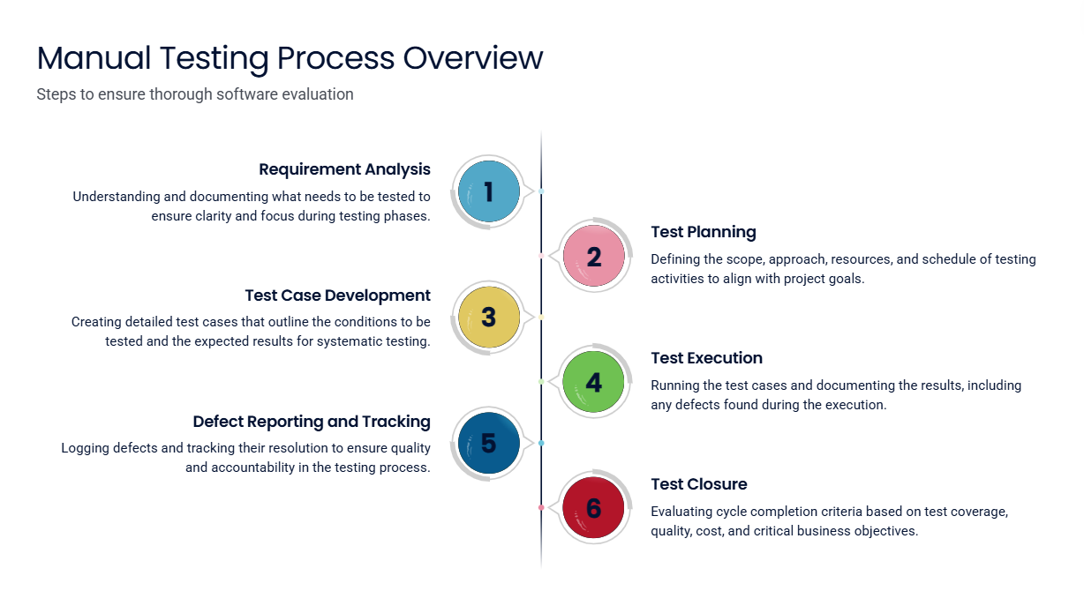

Slide 6
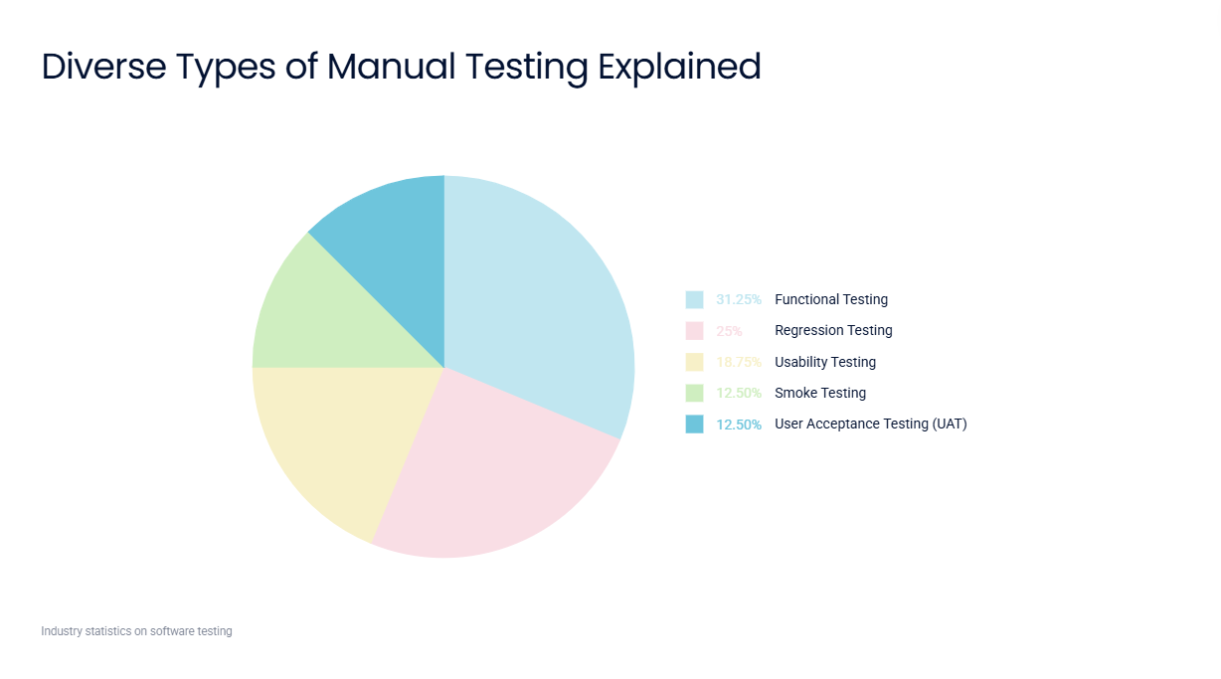

Slide 7
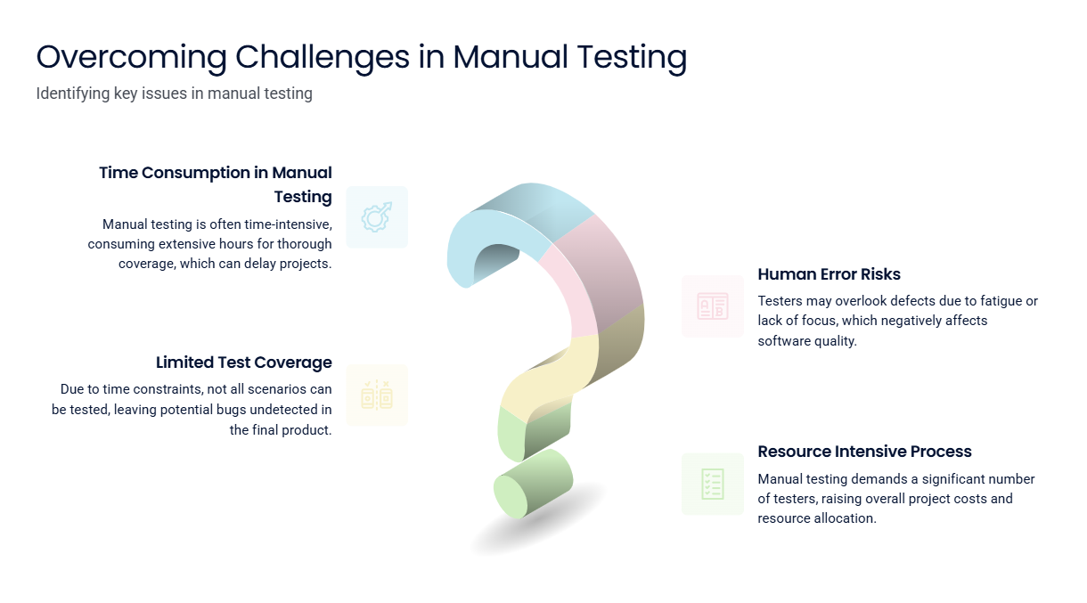

Slide 8
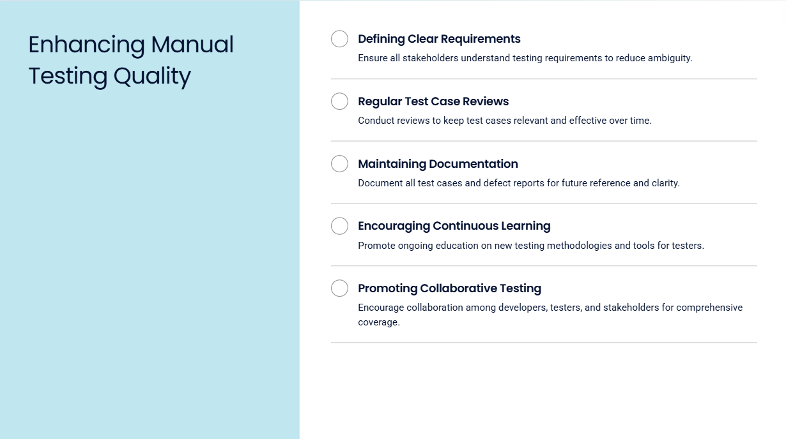

Slide 9
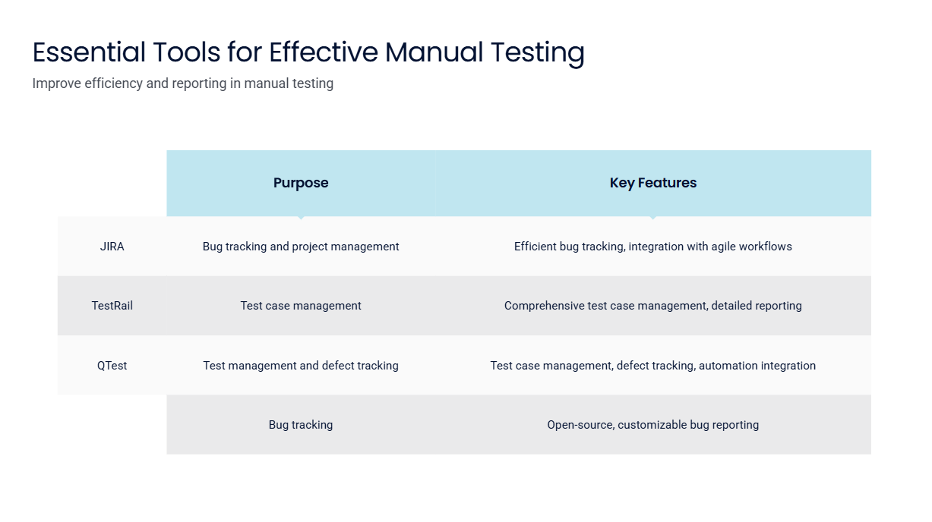

Slide 10
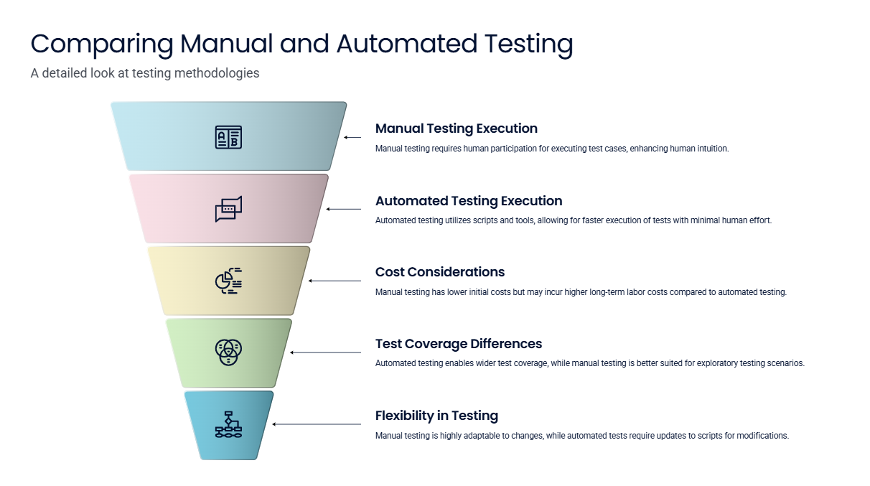

Slide 11
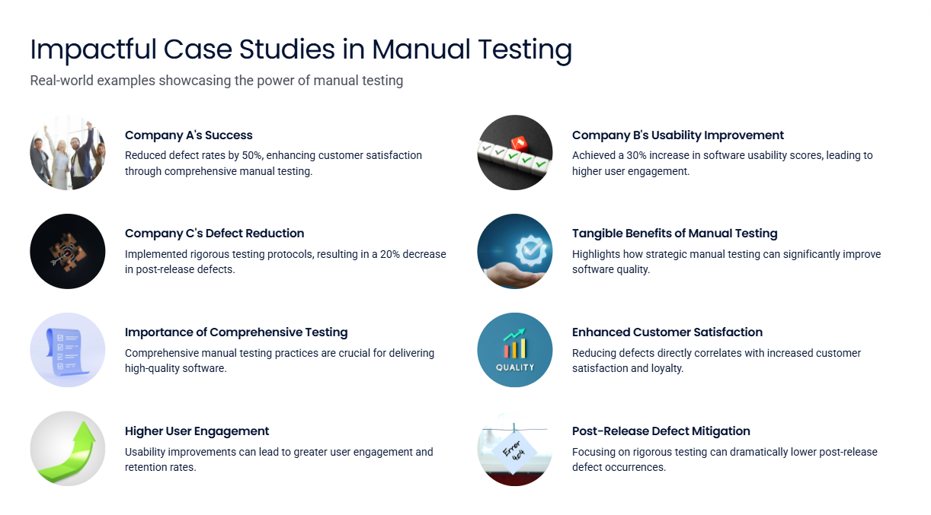

Slide 12
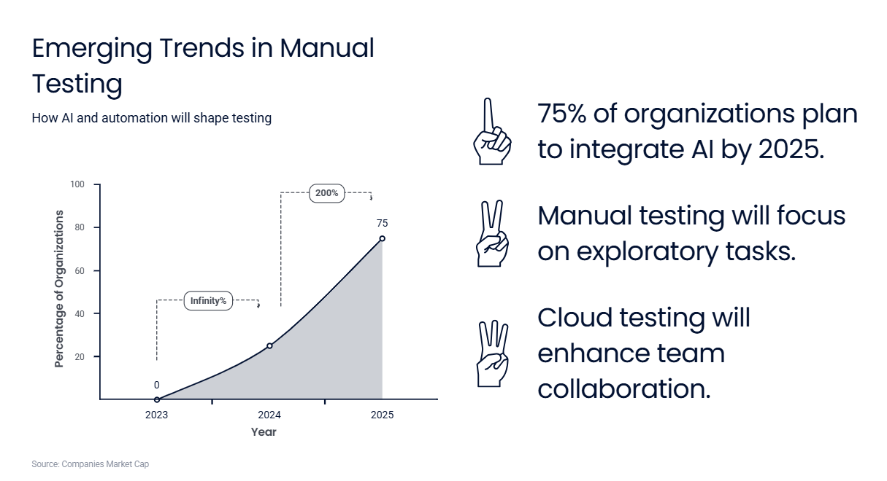

Slide 13
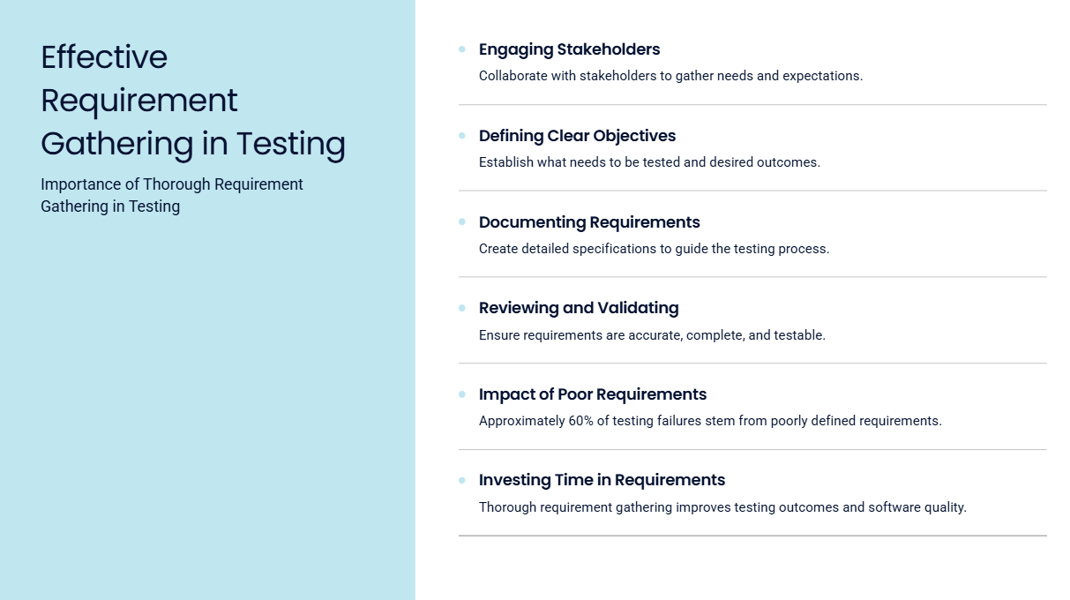

Slide 14
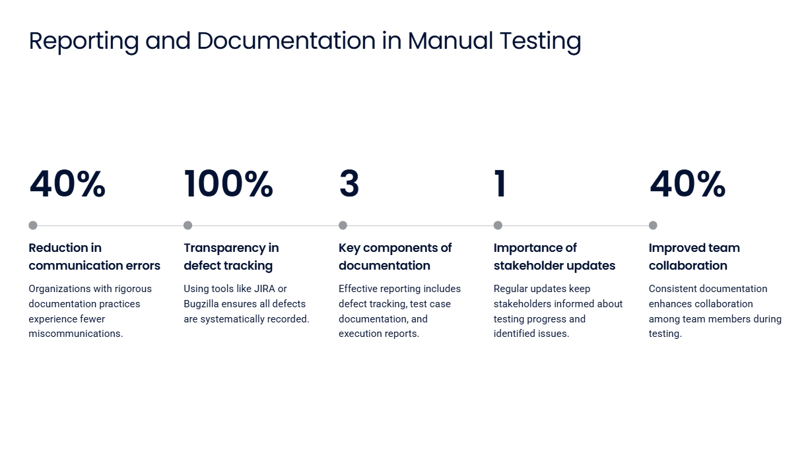

Slide 15
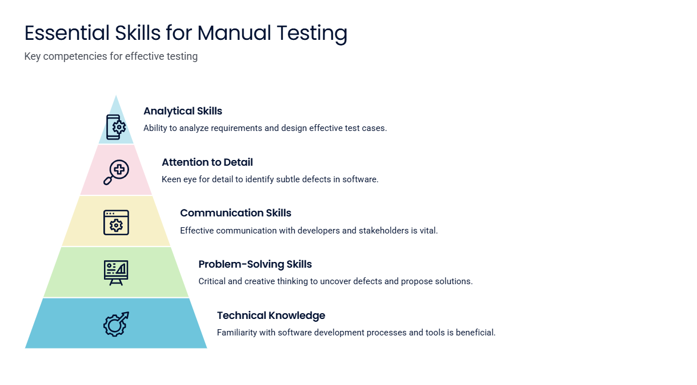

Slide 16
Thank YoU

Slide 17
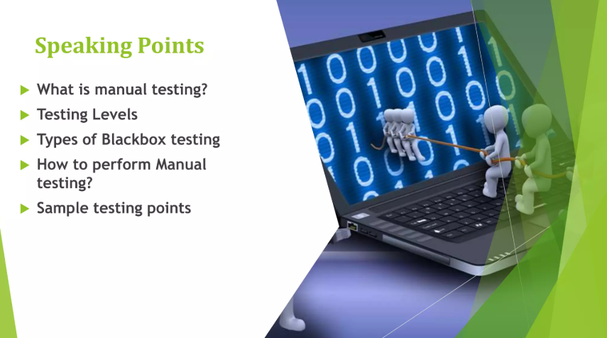

Slide 18


Slide 19
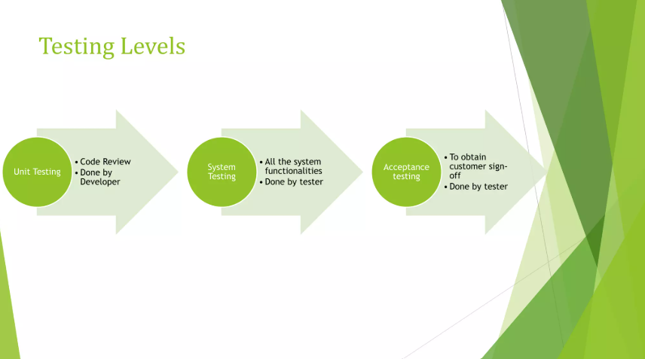

Slide 20
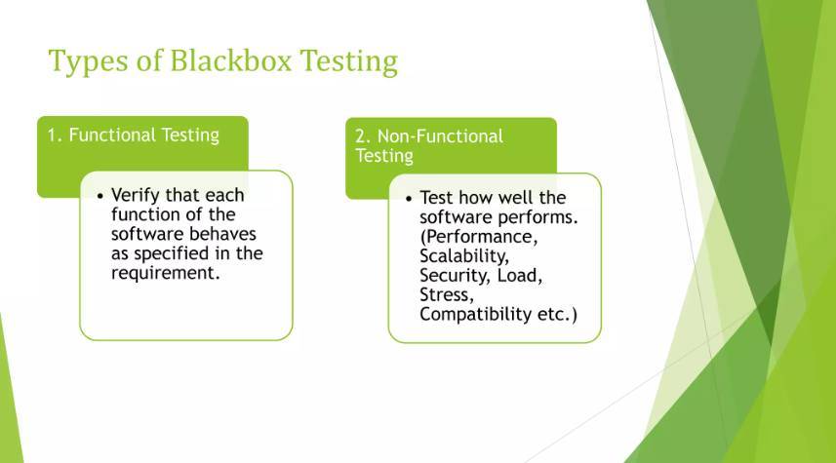

Slide 21


Slide 22
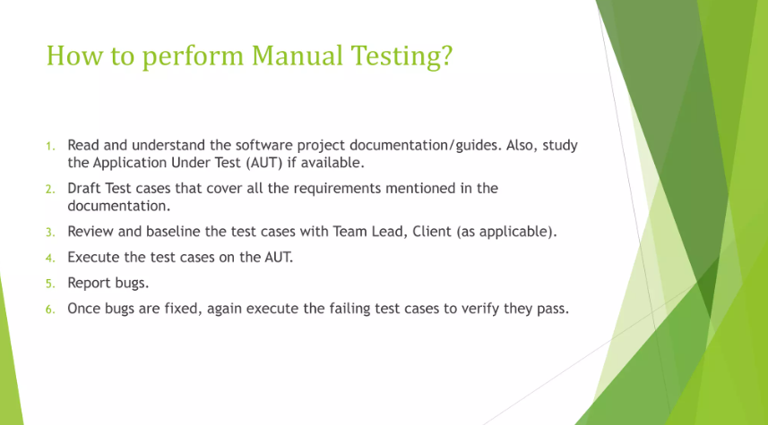

Slide 23


Slide 24
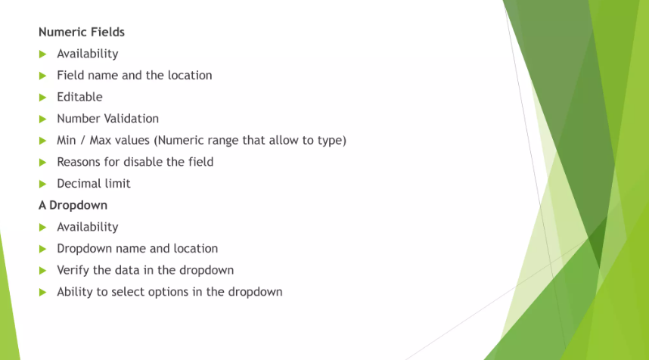

Slide 25
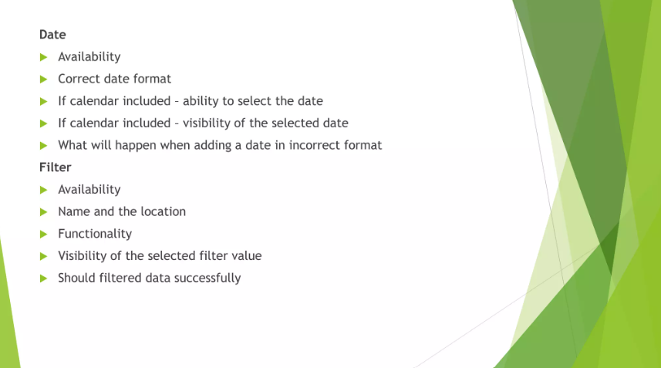

Slide 26


Slide 27
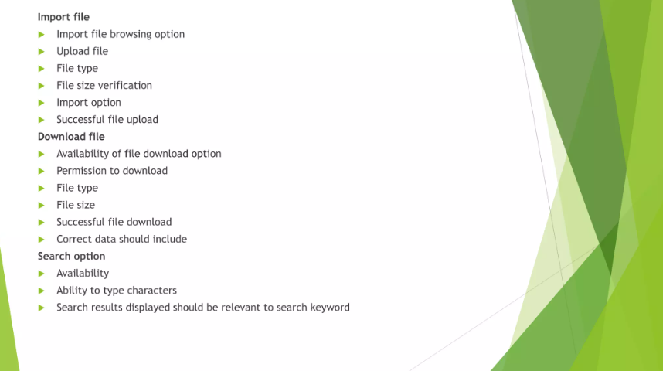

Slide 28
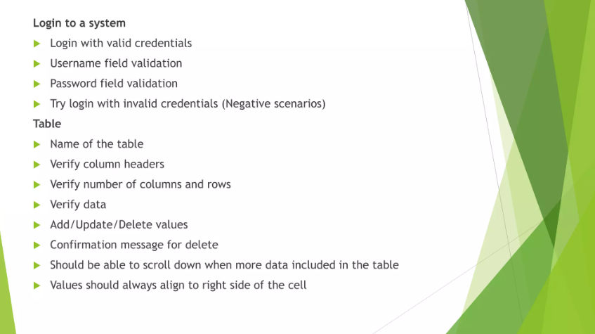

Slide 29
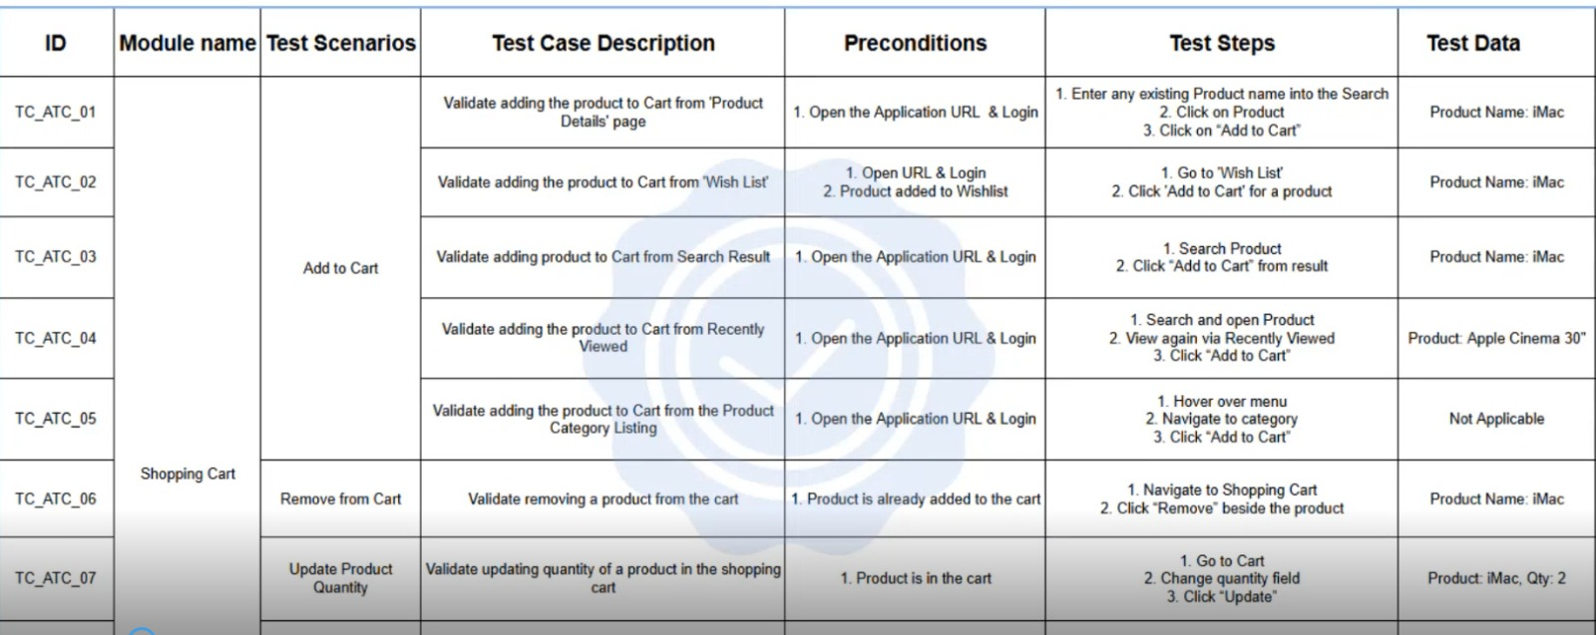

Slide 30
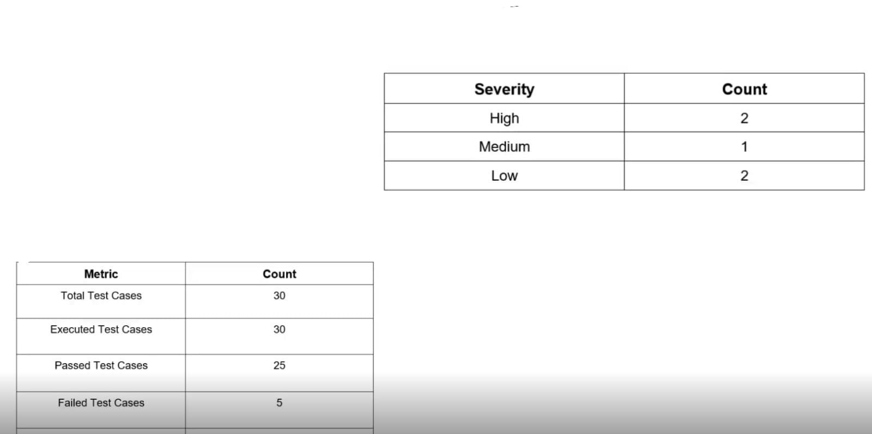

Slide 31
API Testing with Postman
for Simple Books API
Software Tester (ALX2_SWD6_G1)
Group 2

Slide 32
Introduction
API Testing ensures endpoints behave as expected.
Postman is a powerful tool for API development and testing.
This project uses the "Simple Books API" for hands-on learning.

Slide 33
Project Objectives
Automate functionality testing of a RESTful API using Postman.
What it validates:
Correct behavior of API endpoints.
CRUD operations (Create, Read, Update, Delete) for orders and books.
Use variables and scripting to create dynamic test flows.
Generate and interpret test results.

Slide 34
Test Plan Overview
A total of 15 test cases (requests) were implemented, comprising 25 tests (assertions).
Covers status check, registration, book and order operations.
Both valid (pass) and invalid (fail) scenarios tested.

Slide 35
Tools Used
Simple Books API: A sample API used to test various HTTP methods, authentication, and validation logic.
Postman: For sending API requests, writing test scripts, and managing collection.
JavaScript: Used for writing custom test assertions and handling error scenarios.
Newman: Command-line tool for running Postman collections outside the GUI and automating test execution.
newman-reporter-htmlextra: Reporter used with Newman to generate detailed, visually rich HTML test reports.

Slide 36
Key Insights
Visualized with Screenshots

Slide 37
API Endpoints Covered
GET/status
Test 02
List of books
GET/books
Tests 03, 04
Get a single book
GET/books/:bookId
Test 01
Status
POST/api-clients/
Tests 05, 06
API Authentication

Slide 38
API Endpoints Covered
Test 09
GET/orders
Get an order
GET/orders/:orderId
Get all orders
DELETE/orders/:orderId
Tests 12, 13
Update an order
Tests 14, 15
Delete an order
PATCH/orders/:orderId
Tests 07, 08
Submit an order
POST/orders
Tests 10, 11

Slide 39
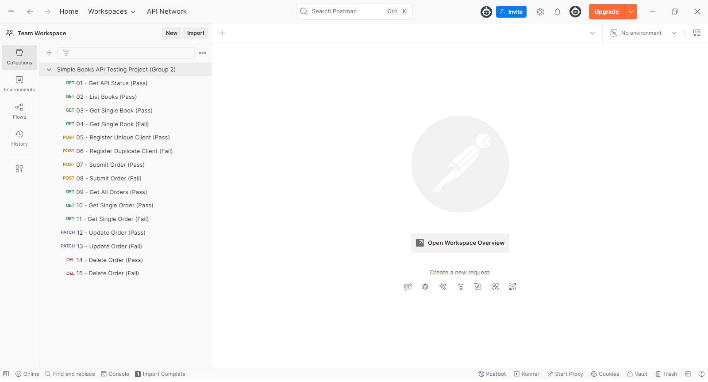
Collection Structure

Slide 40
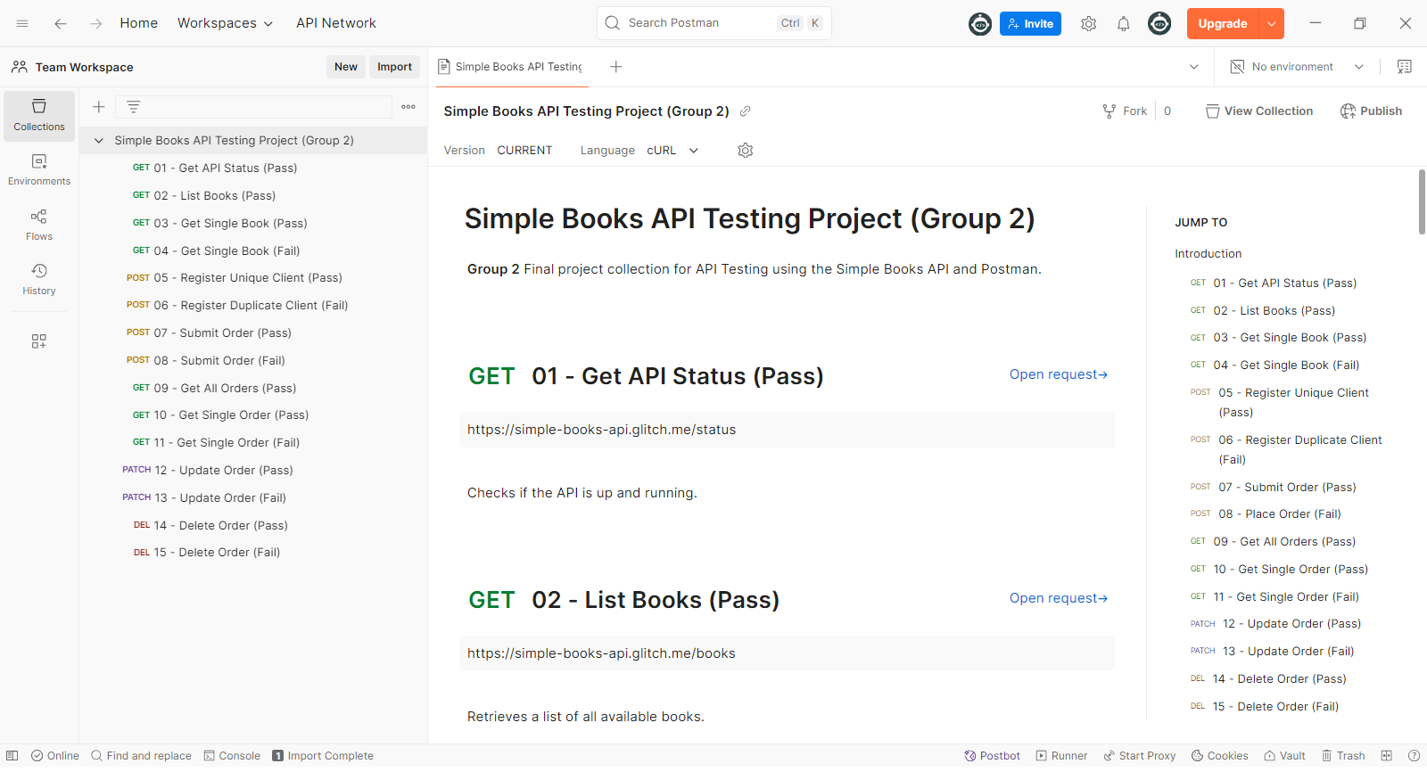
Documented collection with request descriptions

Slide 41
Variables
Used collection variables for extracting the following dynamic values from responses:
clientName
clientEmail
accessToken
bookId
orderId
invalidName
invalidId

Slide 42
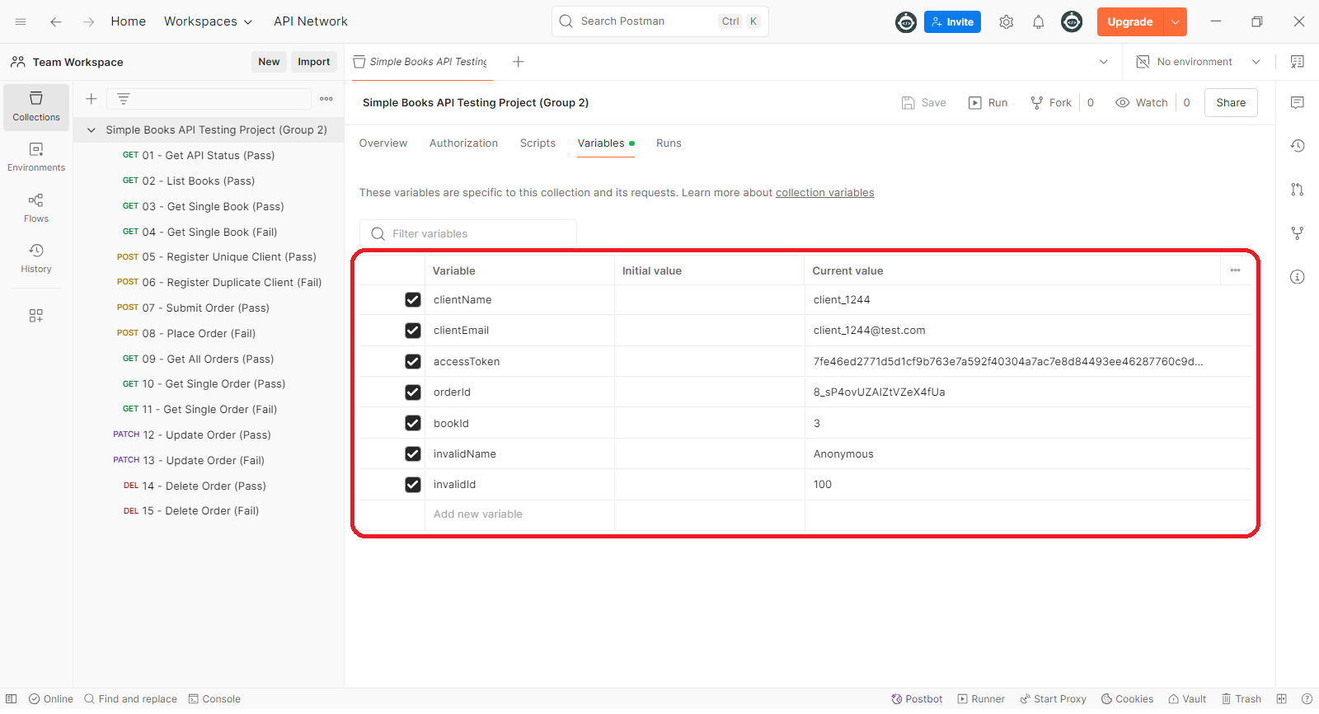
Using Collection Variables to Extract Dynamic Response Values and Store Invalid Inputs for Negative Testing

Slide 43
Authorization Headers
Used Authorization headers with Bearer tokens to access secured endpoints.
Retrieved and stored the Bearer token dynamically after successful registration.
Applied the token across all requests using collection-level variables for consistency and maintainability.

Slide 44
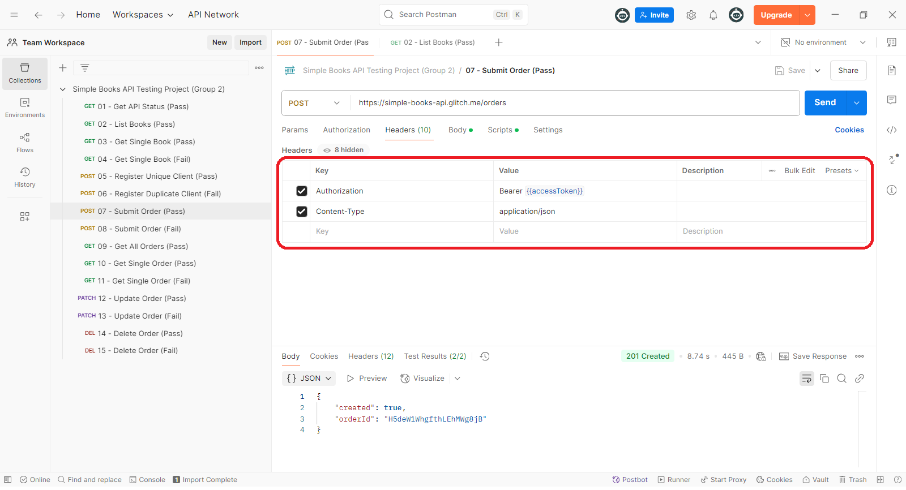
Test 07: Submit Order (Pass) Used authorization header with Bearer token

Slide 45
Validation
Used test scripts to validate response status and structure for requests with expected response content, such as verifying HTTP 200 responses and ensuring the presence of required fields like id, name, and author in the JSON response (e.g., GET Single Book).

Slide 46
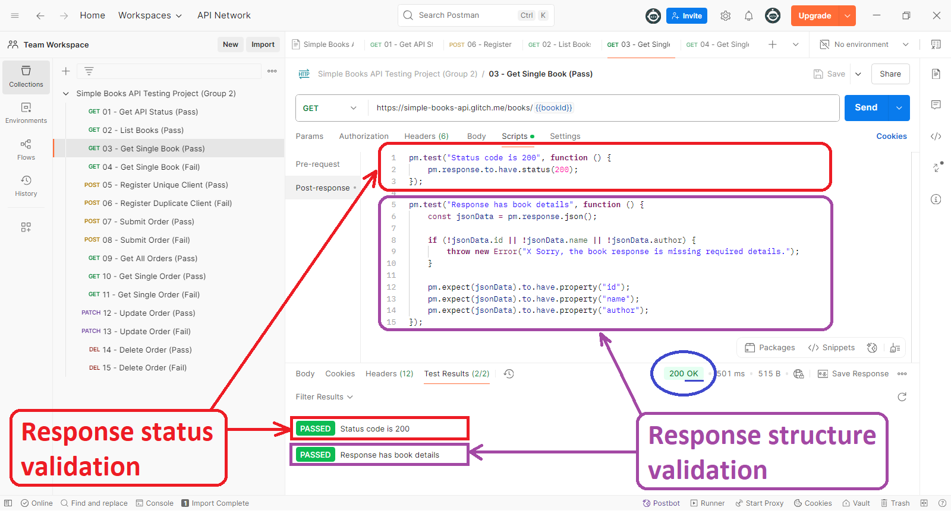
Test 03: Get Single Book (Pass) Test scripts to validate response status and structure

Slide 47
Validation
While also validating response status for requests with no content in valid scenarios, like HTTP 204 responses (e.g., Update Order).

Slide 48
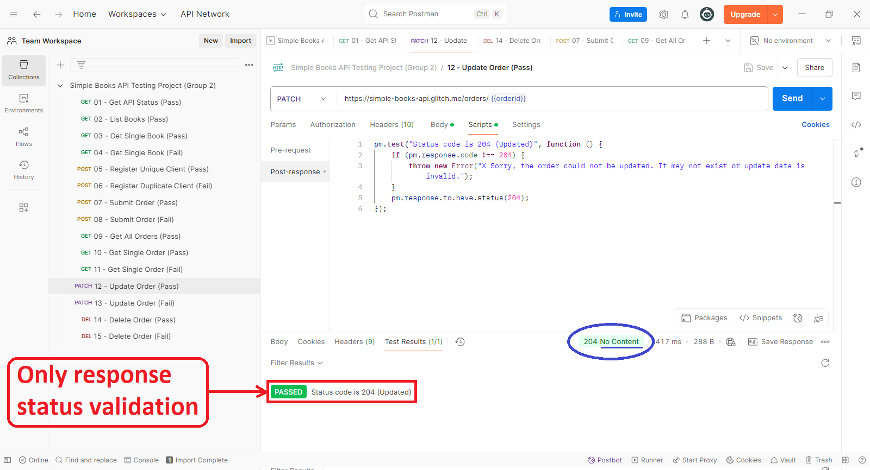
Test 12: Update Order (Pass) Test script to validate response status only

Slide 49
Pass Test Example
Test: 01 - Get API Status.
Checks if API is up and returns status 200.
Asserts that response JSON includes 'status: OK’.

Slide 50
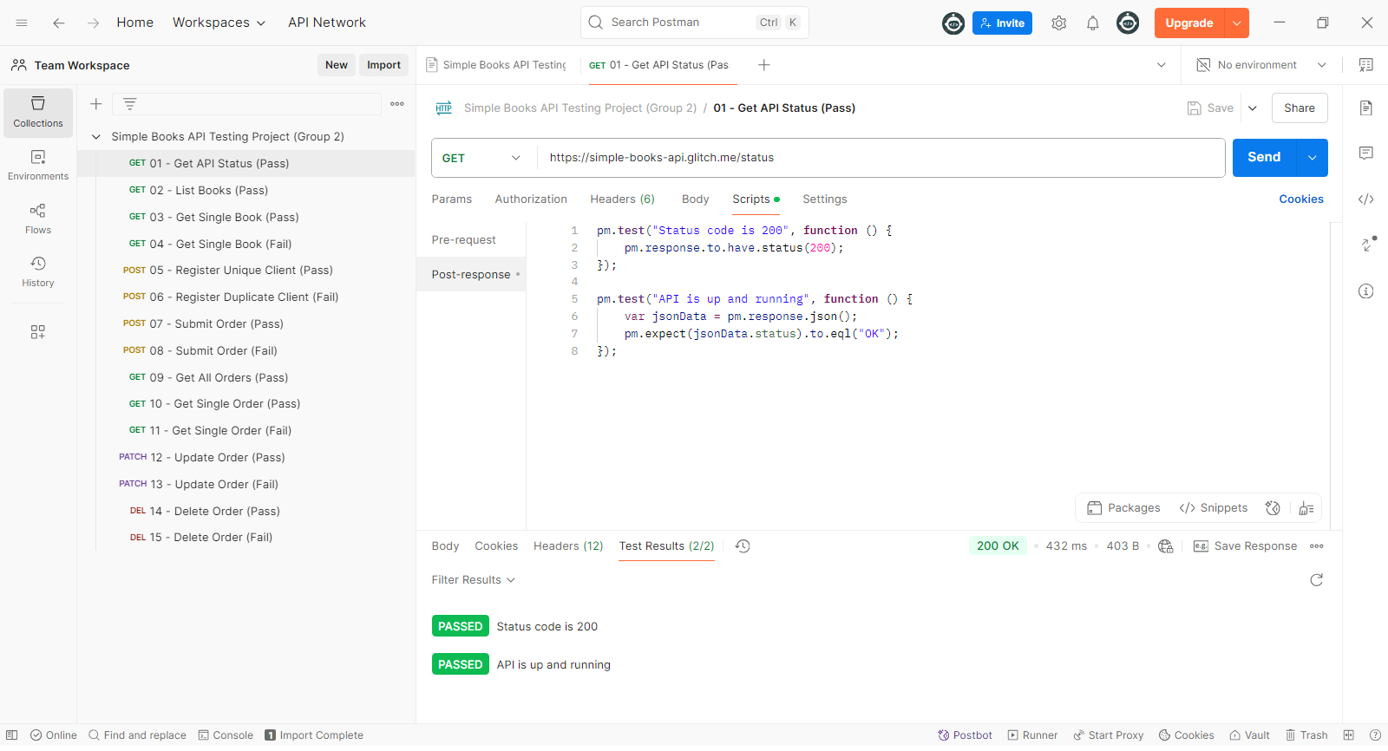
Test 01: Get API Status (Pass) Example Pass Test

Slide 51
Fail Test Example
Test: 06 - Register Duplicate Client.
Attempts to register same client twice.
Fails as email must be unique – useful to check validations.

Slide 52
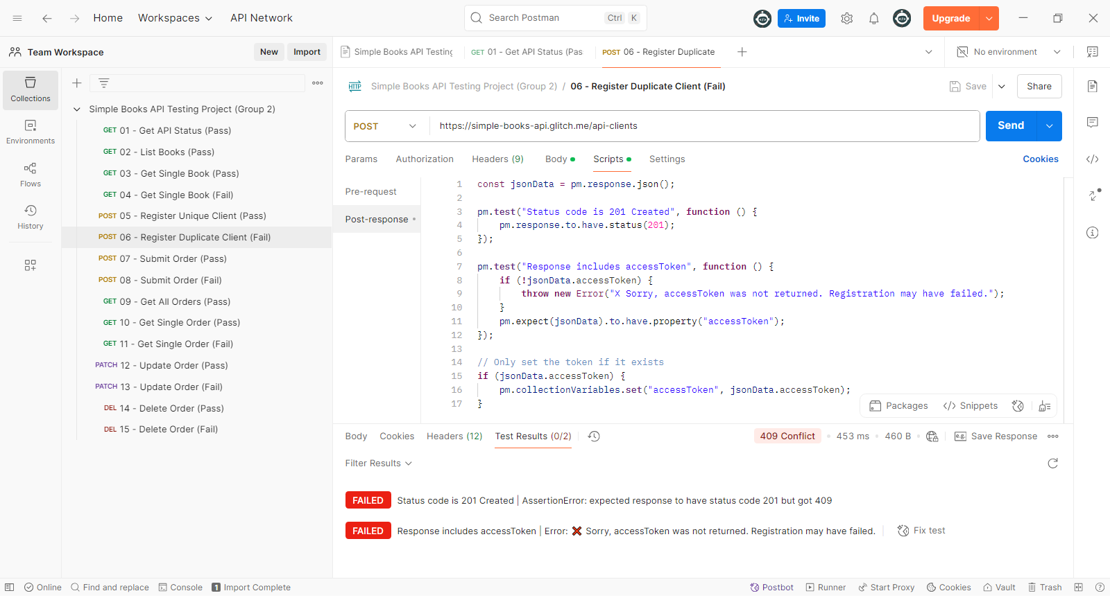
Test 06: Register Duplicate Client (Fail) Example Fail Test

Slide 53


Collection Run (Recording)

Slide 54
Summary of Results
Passed Tests: Majority.
Fail Tests: Intentionally triggered to verify invalid cases.
The collection tests validated expected API behavior.

Slide 55





Test Outcome Summary
Request Name | Overall Status
01 - Get API Status (Pass) | Pass
02 - List Books (Pass) | Pass
03 - Get Single Book (Pass) | Pass
04 - Get Single Book (Fail) | Fail
05 - Register Unique Client (Pass) | Pass
06 - Register Duplicate Client (Fail) | Fail
07 - Submit Order (Pass) | Pass
08 - Place Order (Fail) | Fail
09 - Get All Orders (Pass) | Pass
10 - Get Single Order (Pass) | Pass
11 - Get Single Order (Fail) | Fail
12 - Update Order (Pass) | Pass
13 - Update Order (Fail) | Fail
14 - Delete Order (Pass) | Pass
15 - Delete Order (Fail) | Fail

Slide 56
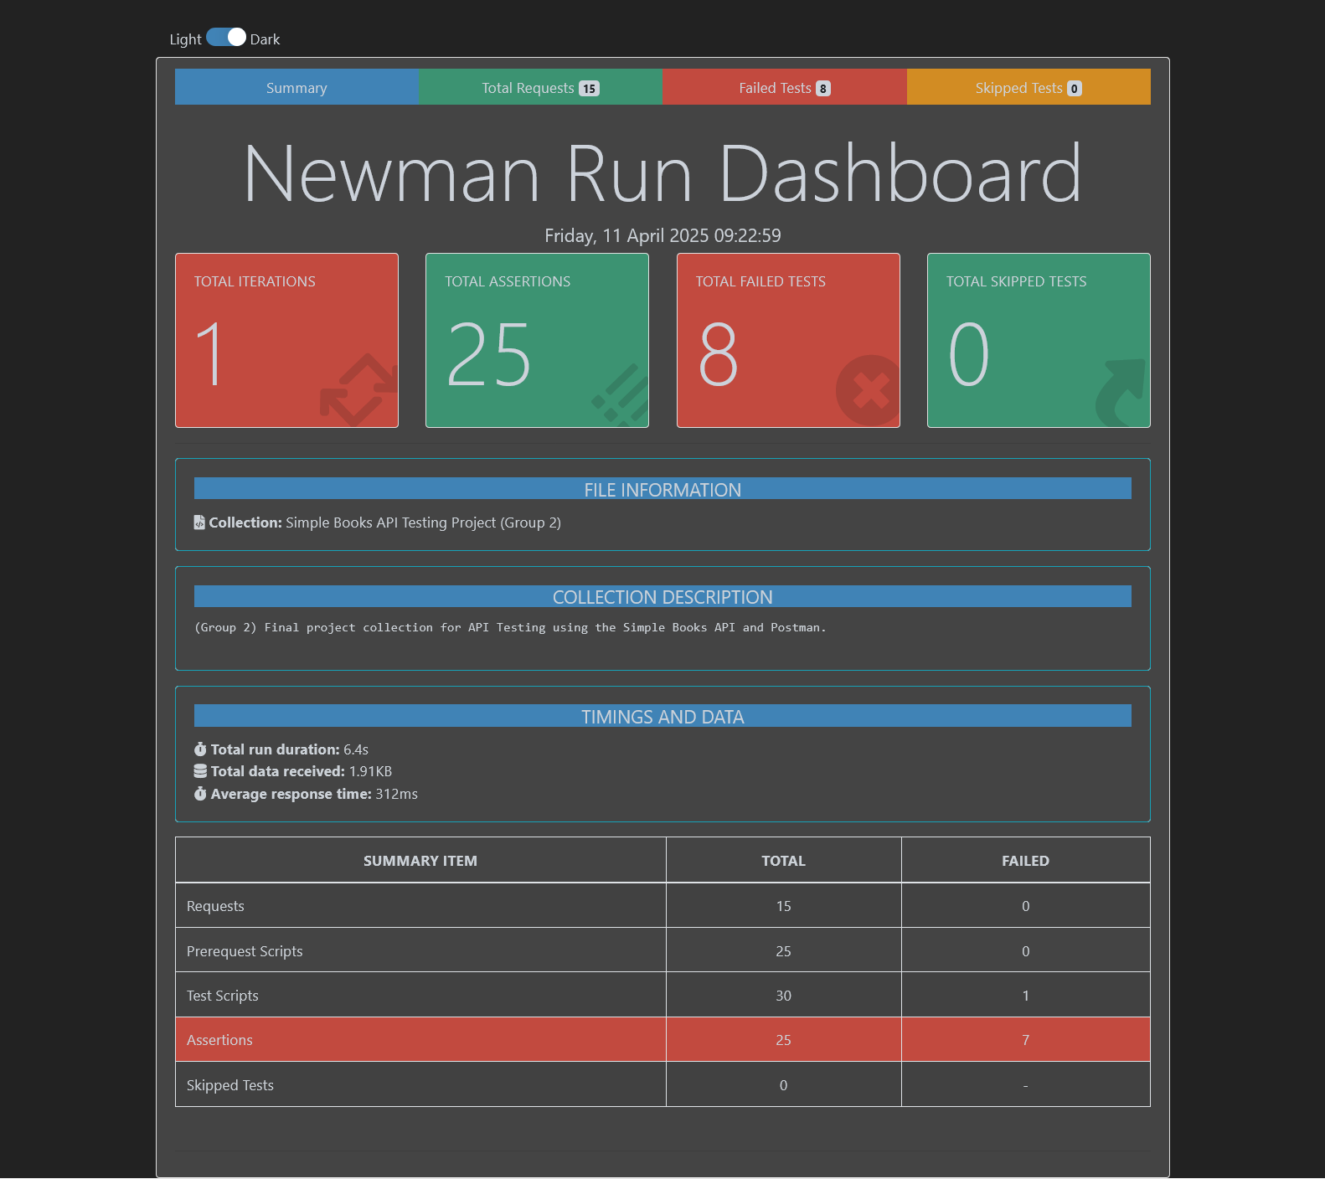
Test Outcome Report Summary

Slide 57
Test Outcome Report Summary

Slide 58
Test Outcome Report Summary

Slide 59
Conclusion
Gained hands-on experience with API testing tools.
Learned how to structure tests and validate outcomes.
Important to include negative tests to cover real-world scenarios.

Slide 60
Thank You
Questions?

Slide 61
Automated Testing Framework
for a Web Application
Software Tester (ALX2_SWD6_G1)
Group 2

Slide 62
Introduction
What is Test Automation?
Definition:
Using software tools to execute automated tests and validate application functionality.
Saves time and effort compared to manual testing.
Why Selenium?
Open-source tool for browser automation.
Supports multiple browsers (Chrome, Firefox, etc.).
Integrates with TestNG, Maven, and CI/CD pipelines.

Slide 63
Tools Overview
Key Tools for Automation
Selenium WebDriver:
Core tool for browser interaction.
Supports Java, Python, C#, etc.
TestNG:
Framework for test management and reporting.
Maven:
Dependency and build management.
IDEs:
Eclipse/IntelliJ for code development.
JDK:
Java Development Kit.

Slide 64

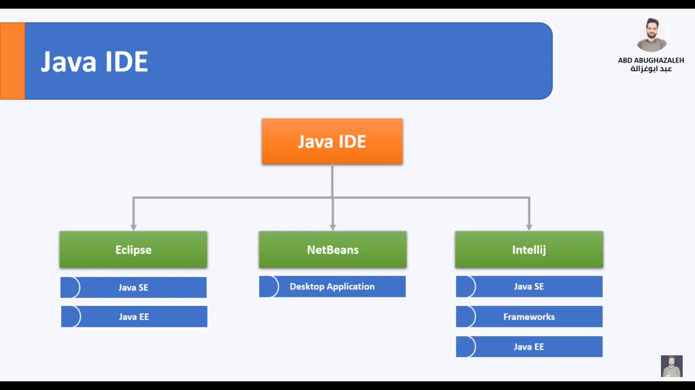


Slide 65
Setting Up the Environment
Install JDK and set JAVA_HOME.
Configure IDE (Eclipse/IntelliJ).
Add dependencies in pom.xml:
Initialize WebDriver:

Slide 66
Open/Close:
java
Copy
driver.quit(); // Close browser
Navigation:
java
Copy
driver.navigate().to("https://new-url.com");
driver.navigate().back();
Browser Navigation Basics

Slide 67
By ID:
driver.findElement(By.id("element-id"));
By XPath:
driver.findElement(By.xpath("//div[@class='example']"));
By CSS:
driver.findElement(By.cssSelector("div.example"));
Finding Web Elements

Slide 68
Common Actions on Elements
Input Text:
element.sendKeys("Text here");
Click:
element.click();
Dropdowns:
Select dropdown = new Select(element);
dropdown.selectByVisibleText("Option 1");

Slide 69
Waiting for Dynamic Elements
Explicit Wait:
WebDriverWait wait = new WebDriverWait(driver, Duration.ofSeconds(10));
wait.until(ExpectedConditions.visibilityOf(element));

Slide 70
Handling Alerts & Frames
Alerts:
Alert alert = driver.switchTo().alert();
alert.accept();
Frames:
driver.switchTo().frame("frame-name");

Slide 71
Writing Test Cases with TestNG
Annotations:
@BeforeTest → Setup
@Test → Test Logic
@AfterTest → Teardown
Test Suite XML:
<suite name="TestSuite">
<test name="Regression">
<classes>
<class name="com.tests.LoginTest"/>
</classes>
</test>
</suite>

Slide 72
Generating Test Reports
TestNG HTML Reports: Built-in.
ExtentReports: Customizable dashboards.

Slide 73
Benefits:
Code reusability and maintainability.
Example:
public class LoginPage {
WebDriver driver;
public LoginPage(WebDriver driver) {
this.driver = driver;
}
public void login(String username) {
driver.findElement(By.id("username")).sendKeys(username);
}
}
POM Best Practices

Slide 74
Integrating with Jenkins
Steps:
Create a Jenkins Pipeline.
Link to GitHub/GitLab repositories.
Schedule automated test runs.

Slide 75
Containerized Testing with Docker
Benefits:
Consistent environments.
Parallel execution via Selenium Grid.
Dockerfile Example:
FROM selenium/node-chrome
COPY . /app
CMD ["java", "-jar", "test-suite.jar"]

Slide 76
Conclusion
Automation improves software quality and efficiency.
Tools like Selenium, TestNG, and Jenkins streamline workflows.
POM and Docker enhance maintainability and scalability.

Slide 77

Thank You

